Slide 1

Insights about Bike (2017 till to date)

Slide 2

Agenda
Objectives/ Problem Statement
Year Wise Trend Analysis
Geographic Trend Analysis
Network Analysis
Segment Analysis
Conclusion

Slide 3
Objective/ Problem Statement
To study the behavior of different segments – Bike Owners
To analyze the shift of New Bikers towards different MAKES
To study behavior shift within a MAKE – i.e. from one model of Harley Davidson to another model of same MAKE
Year wise trend analysis
Geographical Analysis of Bikers - Previous vs Current Bikes
Especially explaining how owners have migrated from sub segments of Harley Davidson to other brands sub segments each year since 2017

Slide 4
Interesting Facts about Bikes
Honda: Honda is known for producing reliable, efficient bikes that are great for everyday use. They offer a range of models, from sport bikes to cruisers, and are a popular choice for beginner riders.
Suzuki: Suzuki is a Japanese company that produces high-performance bikes, often used in racing competitions. They are also known for their sport touring models, which are designed for long-distance rides.
Indian Motorcycles: Indian is an American company that has been producing bikes since 1901. They are known for their classic styling and high-end features, making them a popular choice for riders who value luxury and quality.
Victory: Victory is an American company that specializes in cruisers and touring bikes. They are known for their powerful engines and distinctive styling, with many models featuring unique design elements like angular fairings and custom paint jobs.
Harley Davidson: Harley Davidson is one of the most well-known and iconic motorcycle brands in the world. They are known for their classic American style, powerful engines, and rugged durability, making them a popular choice for riders who value tradition and craftsmanship.

Slide 5
Interesting Facts about Changing Bike Make
Desire for new features or technology: One of the most common reasons for switching bike models or brands is the desire for new features or technology. For example, a rider may switch from a Honda to a BMW because they want a bike with advanced electronics or more sophisticated suspension.
Changing needs or interests: People's riding needs and interests can change over time, leading them to switch to a different bike brand or model. For example, a rider who previously owned a sport bike may switch to a cruiser for a more comfortable ride.
Cost considerations: Cost is also a significant factor in bike buying decisions. A rider may switch to a different brand or model if they find a better deal or if the cost of maintenance and repairs for their current bike becomes too high
Brand loyalty: Some riders are fiercely loyal to a particular bike brand, but may switch to a different model within the same brand if it better suits their needs or offers new features they desire.
Image and reputation: Bike brands and models can carry a certain image and reputation, and some riders may switch to a different brand or model to align with a particular image or reputation they value.

Slide 6
Interesting Facts about Changing Model
Desire for different riding style: A rider may switch from a sport bike to a cruiser or touring model within the same brand to suit their changing riding style or preferences.
Upgrades or improvements: Bike manufacturers frequently update their models with new features, improved performance, and updated styling, which may entice riders to switch to a newer model within the same brand.
Age and condition of current bike: As a bike ages or accumulates wear and tear, a rider may choose to switch to a newer model within the same brand for improved reliability, performance, and aesthetics.
Personalization and customization: Many riders enjoy customizing and personalizing their bikes, and may switch to a different model within the same brand to have more customization options or to better suit their desired aesthetic.

Slide 7
Year Wise Trend Analysis
From 2020 to 2021 the number of users increase, but decrease from 2021 to 2022 (Inflation!!!)

Slide 8
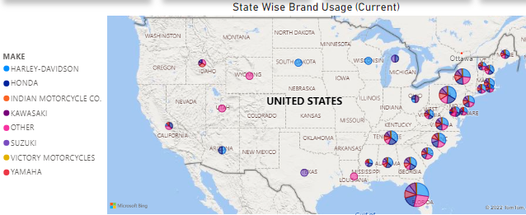
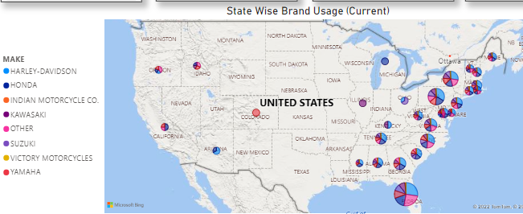
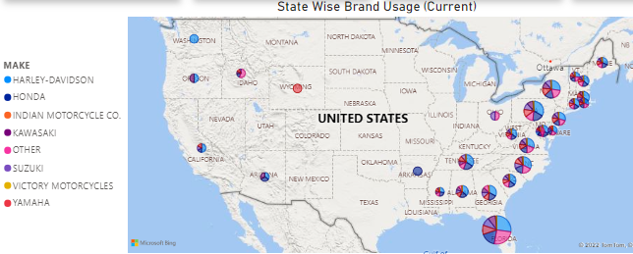
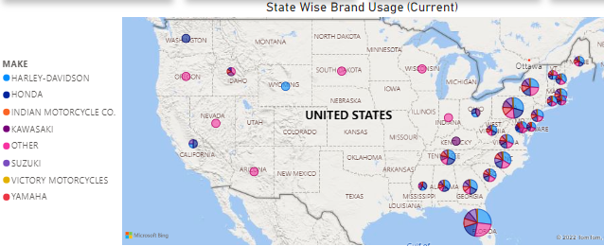
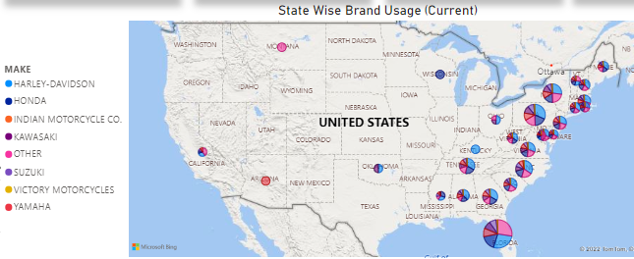
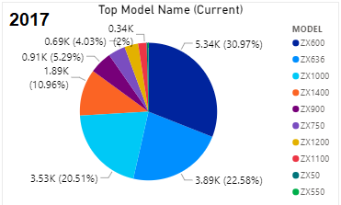
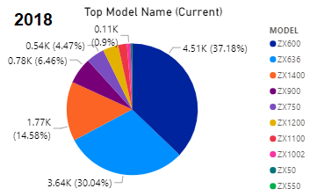
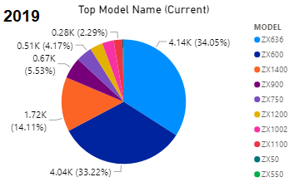
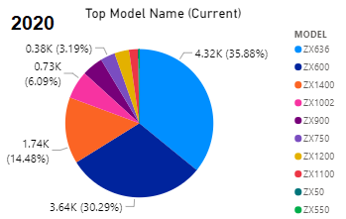
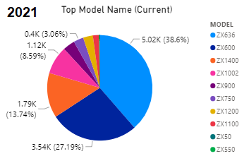
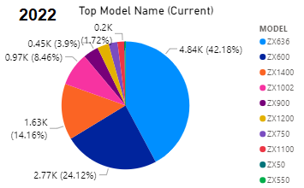
Geo Trend Analysis (MAKE wise Users)
2017 →
2018 →
2019 →
2020 →
2021 →
2022 →

Slide 9
Year Wise New Users – Make Wise
Sample code

Slide 10
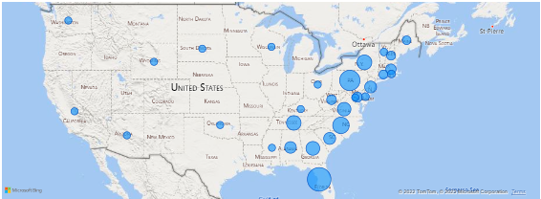
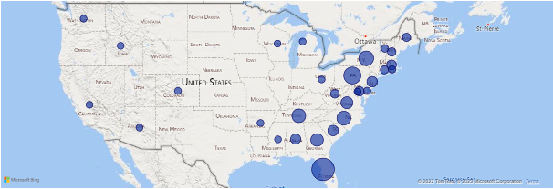
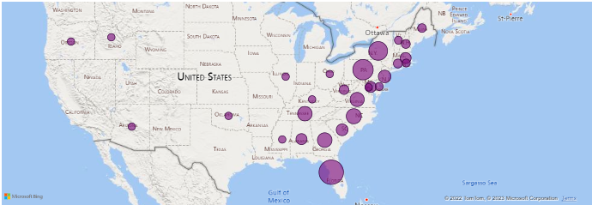
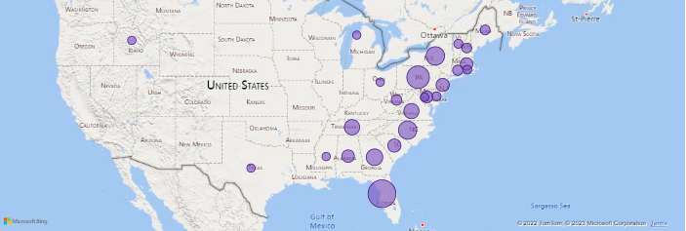
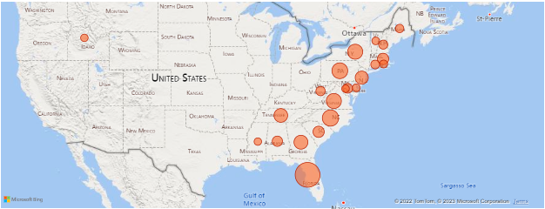
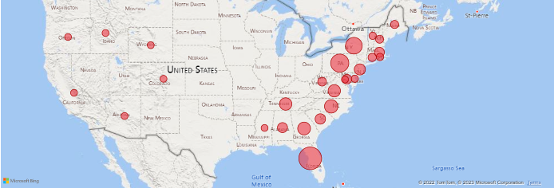
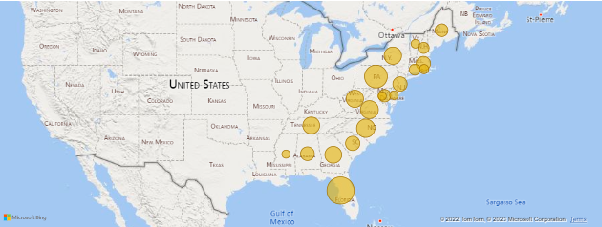
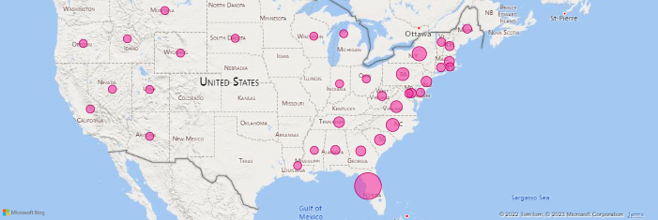
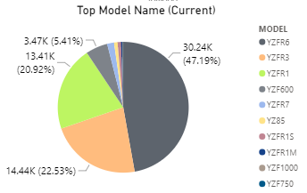
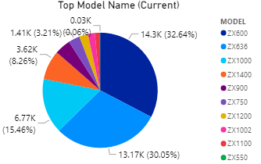
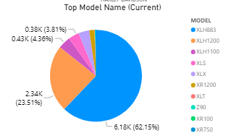
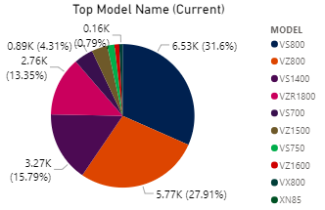
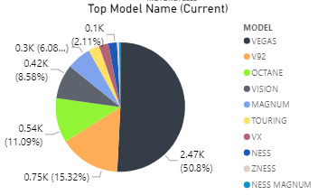
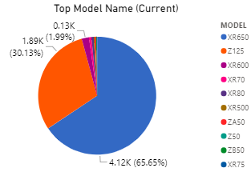
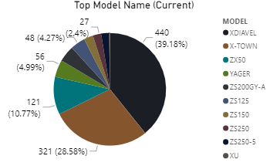
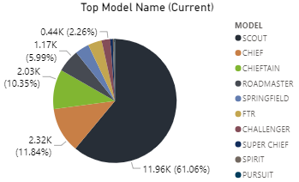
States Where New to Sports Joined
Make Wise Target Locations
Harley Davidson
Honda
Suzuki
Kawasaki
Victory
Yamaha
Indian
Others

Slide 11
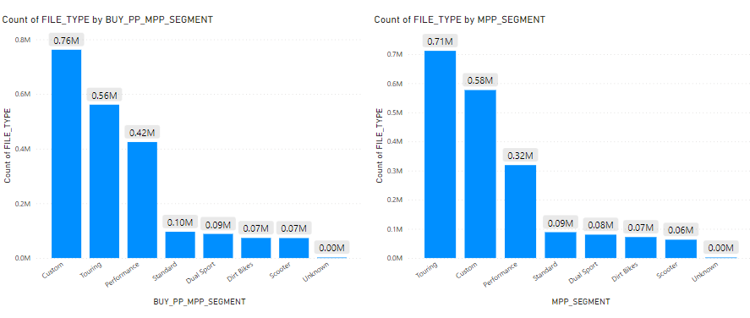
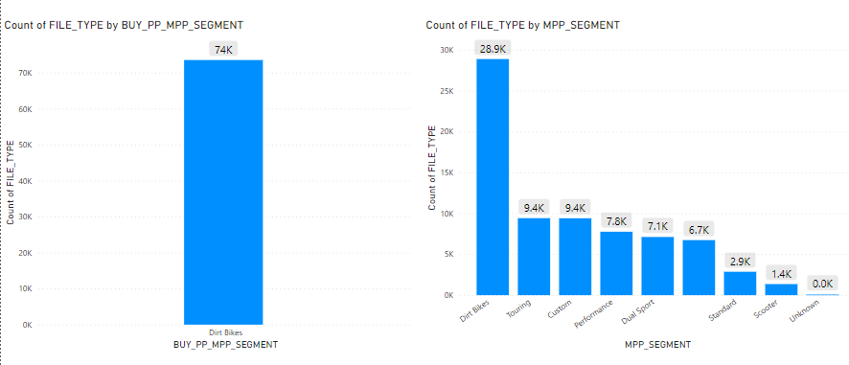
MPP Segment wise – Previous vs Current
Segment clearly shifted from Custom to Touring
If initially someone bought DIRT Bike → then next are touring, custom etc.

Slide 12
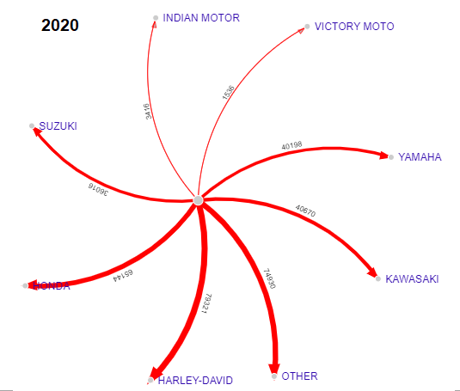
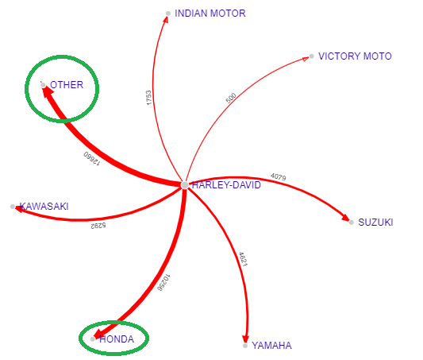
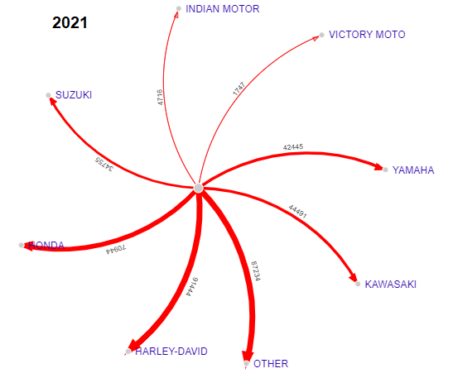
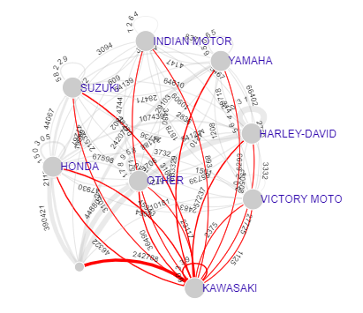
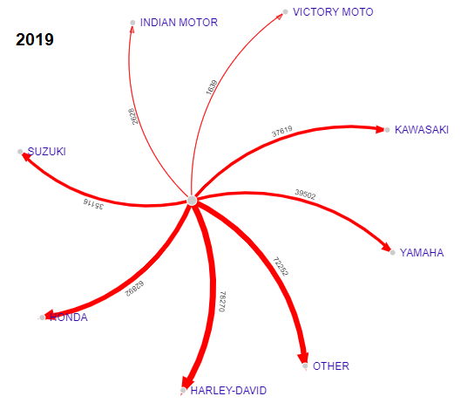
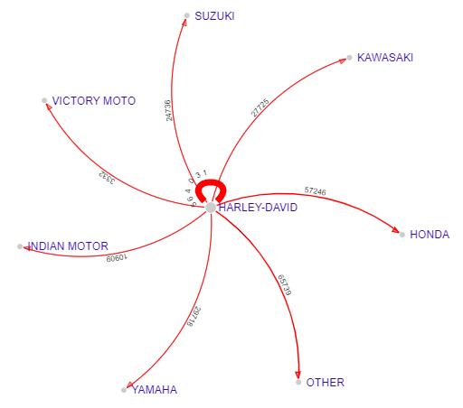
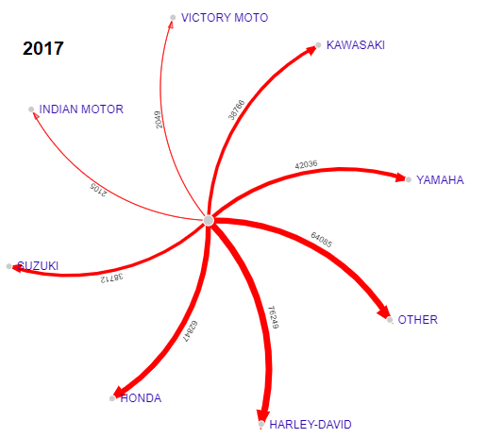
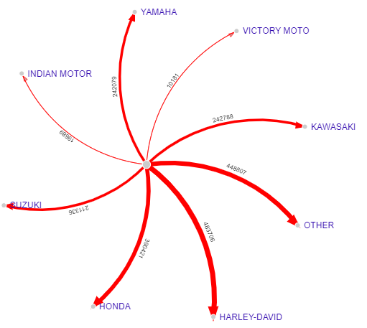
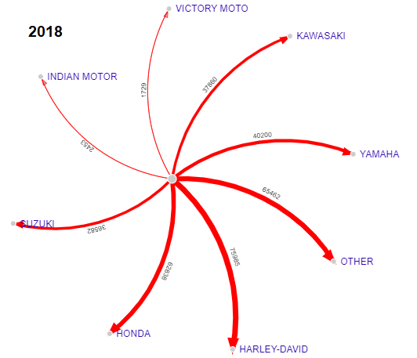
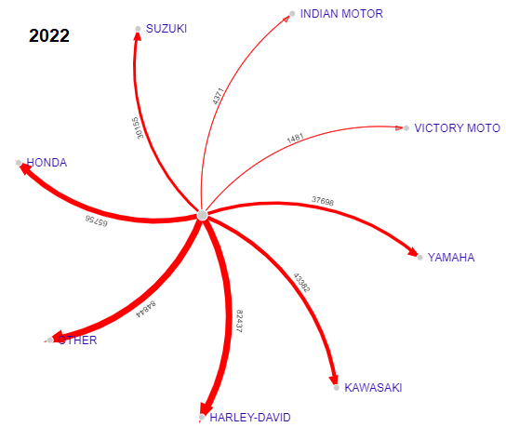
Network Analysis
Overall Shift Network
New to Sports (Mostly join Harley Davidson Models)
From Harley to Others (interesting fact that Harley move to Harley other models)
Year wise New to Sports
People who leave Harley Davidson (move to others)

Slide 13
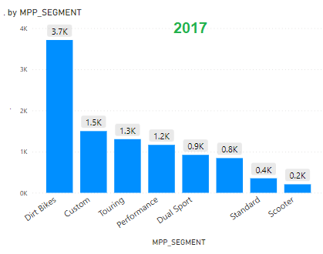
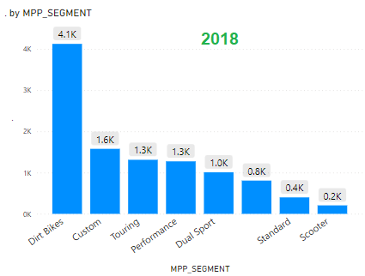
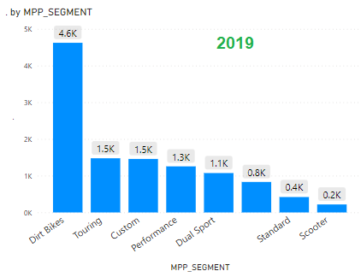
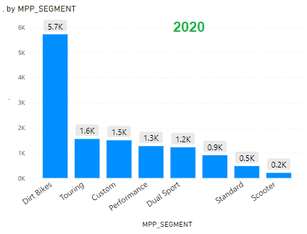
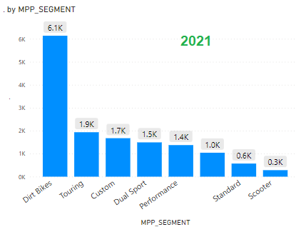
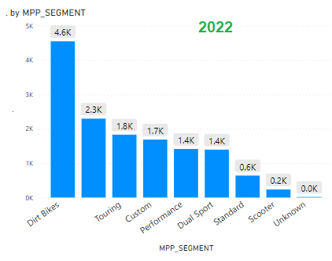
Shifting of MPP Segment Year Wise

Slide 14
Recommendations Based on this Analysis
Harley Davidson being the best Bike Make as per this Analysis, have highest number of models (People have a lot of choices)
Offer a diverse range of models: Bike companies should offer a diverse range of models to appeal to different riders with varying needs, preferences, and budgets. This includes everything from entry-level bikes for new riders to high-end models for experienced enthusiasts.

Slide 15




Recommendations Based on this Analysis
Develop a strong brand identity: A clear and compelling brand identity can help attract new customers and build loyalty among existing riders. This includes everything from a distinctive logo and brand message to a strong social media presence and engaging marketing campaigns.
Honda: The Power of Dreams.
Suzuki: Way of Life!
Indian Motorcycles: Made in America, For All the World.
Victory Motorcycles: Ride One and You'll Own One.
Harley-Davidson: All For Freedom, Freedom For All.

Slide 16
Recommendations Based on this Analysis
Focus on innovation and technology: Many riders value innovation and technology in their bikes, such as advanced electronics, sophisticated suspension, and cutting-edge design. Bike companies should invest in research and development to stay ahead of the curve and offer riders the latest features and technology.
Provide excellent customer service: Great customer service can help build loyalty and attract new customers. Bike companies should offer reliable warranties, quick and efficient repairs, and friendly and knowledgeable staff to help riders get the most out of their bikes.

Slide 17
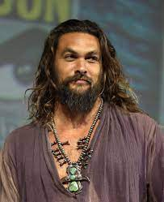
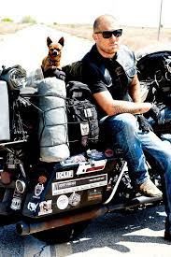
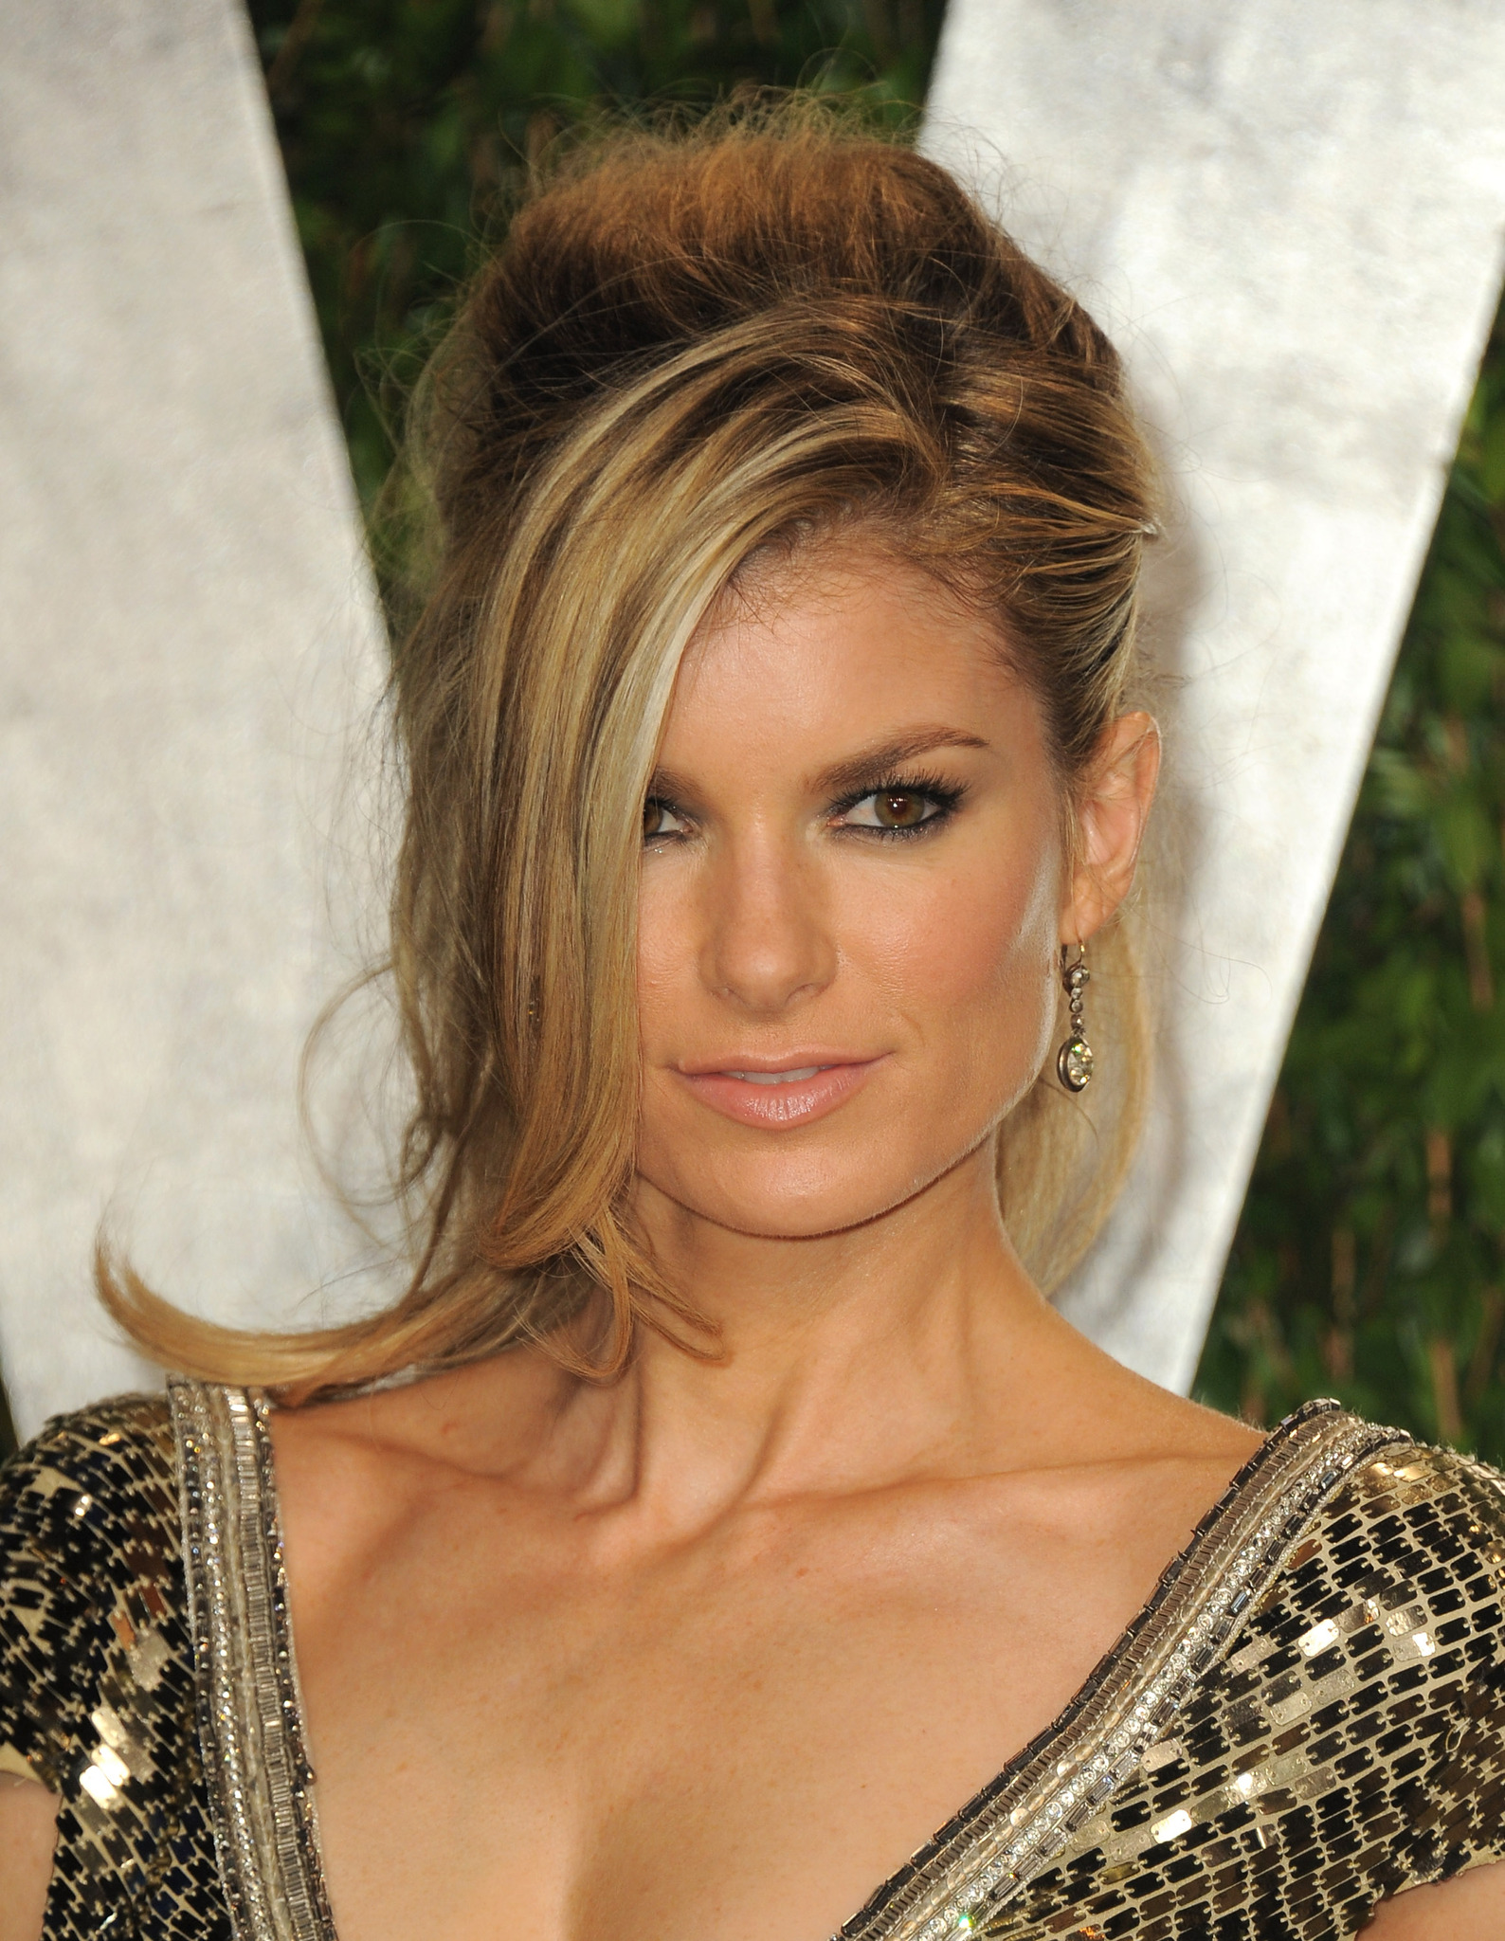

Recommendations Based on this Analysis
Partner with influencers and ambassadors: Partnering with influential riders and brand ambassadors can help spread the word about a bike brand and attract new customers. Bike companies should work with riders who align with their brand identity and share their values, and offer them exclusive access to new models and events.
Example of Harley Davidson Brand Ambassadors

Slide 18
Thank you

